Slide 1



Welspun Corporation
SAP Integration for Pipe Testing Stations
Date: 15th Sep, 2026
www.faclon.com

Slide 2
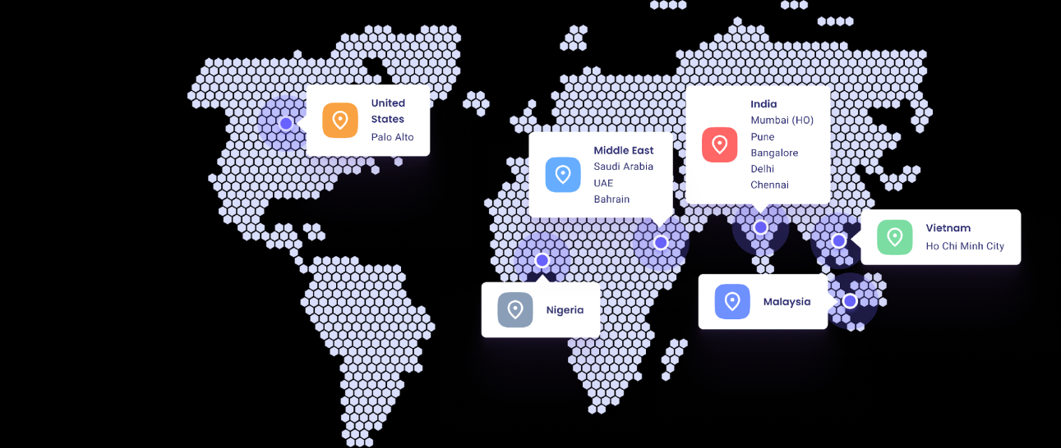

















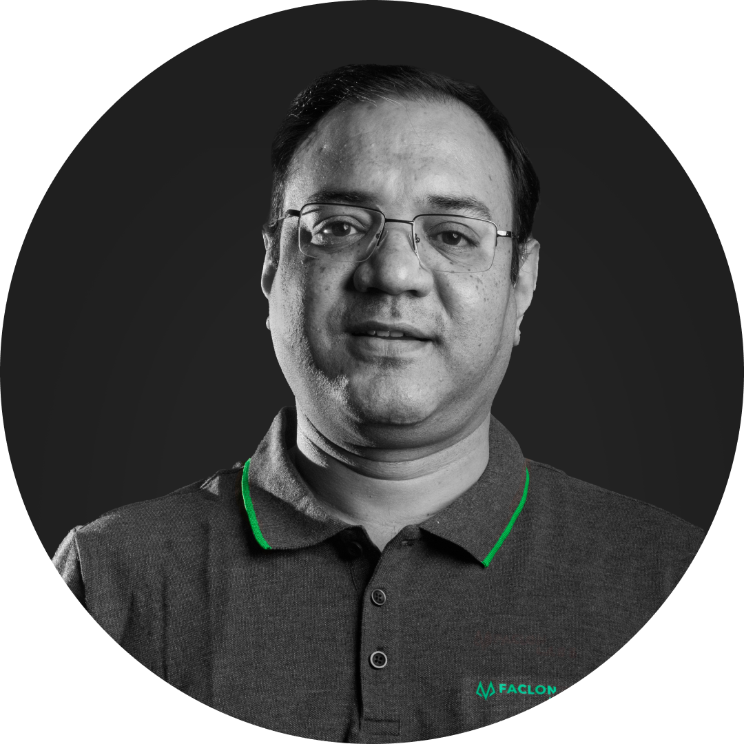




Faclon Labs at a Glance
Leaders in Industrial Data Integration, Visualization, and AI based Optimization
183+
Customers
400+ Deployments
60k+
Assets Connected
5 B+
Data Points Daily
150+
Employees
Rishi Sharma​
Utkarsh Srivastava​
CEO
CTO
B.Tech IIT Bombay
Ex-White Hat Hacker
Backed By
Parth Chaudhary
Vivek Singh​
Sarjan Shah
President of Solution
Chief Data Scientist​
MD, Group Satellite
B. Tech IIT Bombay
B.Tech IIT Kanpur
Archit Naraniwal​
Parag Patil
Jay Kotak
Siddharth Mehra
Chief Sales Officer
Chief Strategic Alliances
B. Tech IIT Bombay
Ex-Wipro, Infosys, RIL
Co-head, Kotak 811
ED, Savita Oil
‹#›

Slide 3






































































Key Customers
Trusted and Ideal digital partner for Industrial setups, commercial setups and OEMs
Automobile &
ancillary
Consumer
Goods
Metals
Cement
Consumer Durables
Chemicals
Energy, Oil & Gas
Pharma
Commercial Infra
OEM tie
-
ups
Partnerships
‹#›

Slide 4
BOTH PROJECTS · OVERVIEW
Objective & Business Outcome
Automatically capture each test result, let the operator review it, and push it to SAP with the correct rules applied.
CURRENT PROCEDURE
OBJECTIVE
BUSINESS OUTCOME
01
Operator counts the indications shown on the UT machine
Capture each result automatically from the machine's PDF report and JPEG image
Faster entry: no manual counting or re-typing
Details typed by hand into SAP against each pipe number
Fewer mistakes: values parsed from the machine report
UT Stations
Decide the result from the prove-up rules saved per PO: MUT, X-Ray or SAT
IUT & FUT · Ultrasonic testing
Consistent results: PO rules applied to every pipe
APPLICATION
Operator reviews and uploads to SAP with the right endpoint and timestamp
Traceable records: PDF report and JPEG image kept with each entry
SAP Entry Application
Slow
Prone to mistakes
02
Test results entered directly into SAP by hand
Pipe number entered before every test — scanned, selected or typed
Printer eliminated: graphs captured and stored digitally
Pressure graph produced on a manual printer
Capture the pressure-vs-time curve digitally from the SCADA over OPC UA
Fewer mistakes: values captured from SCADA; corrections kept on record
Hydrotester
Hydrostatic pressure testing
Operator reviews, corrects and uploads to SAP with both graph images
Right pipe, right record: no pipe number, no saved test
APPLICATIONS
Graph Application + SAP Entry Application
Complete records: standard and actual graphs with each entry
Slow
Prone to mistakes
SAP Integration Proposal · Welspun Corporation
‹#›

Slide 5
01
PROJECT 01 · UT STATIONS (IUT & FUT)
Solution Architecture
What comes in, what the SAP Entry Application computes and verifies, and what reaches SAP.
1
INPUTS
CAPTURE & PARSE
COMPUTE & VERIFY
PUSH TO SAP
2
3
4
UT testing machine
SAP Entry Application · hosted on the central server (IOsense platform)
Normal SAP endpoint
IUT & FUT · per pipe tested
Regular (production) pipes
New entry per test
Automatic result · indications + PO prove-up rule
PDF + JPEG saved for every pipe tested, incl. retests
Indications found?
No
Pipe No
Checksum
PDF test report
JPEG indication image
SAT · pipe accepted
Indication type & count
Result
Report parser
Yes
MUT Prove-Up
Remarks
General remarks
Date / Time
Reads pipe no, test date and indication name & count
PO prove-up rule?
Welspun SAP
X-Ray Prove-Up
Separate SAP endpoint
Read by the application
PO numbers
General remarks
Retest correction
Pipe classification · set by the operator
Previous-station pipe nos.
Suffix _1 / _2 / _3 removed to get the base pipe number
Regular
Calibration · OK / Not OK
Repeatability
Calibration & repeatability pipes
Pipe No
Date / Time
OK / Not OK
SAP timestamp rule
Shown as a separate row in the SAP report
Operator
Remarks
Regular: upload time; PDF test time if the upload succeeds in a later shift
Calibration / repeatability: always the PDF test time
At the IUT / FUT station
Previous-station remarks (operator can append) + testing remarks
File upload (FTP)
Prove-up rule per PO
Pipe type
Operator review
Preview all fields and files
Enter checksum
Press Upload
PDF report + JPEG image
Remarks
Checksum
Upload status shown per entry
Network / SAP down
Previous-station entry missing
Shift end
Calibration alert
Edit after upload
Status per entry
Built-in reliability & alerts
Retry every 5 min, up to 3 times; then marked failed for re-upload
Retry every 5 min until the entry appears
Pending entries highlighted 15 min before the shift ends
Alert if 4 hours pass without a new calibration
All fields editable except indication counts
Preview, uploaded, retrying, waiting; FTP status shown
Cadence TBC with SAP team
SAP Integration Proposal · Welspun Corporation
‹#›

Slide 6
02
PROJECT 02 · HYDROTESTER STATION
Solution Architecture
The pipe number is entered before the test; the Graph Application captures the curve and the SAP Entry Application posts the entry.
1
Hydrotester SCADA
2
Graph Application · runs on a new IPC / Panel PC at the station, replacing the manual printer
At the Hydrotester station
Existing system at the station
Read live pressure
Test starts
Two graphs plotted during the test
Test finishes
OPC UA client reads pressure from the Hydrotester SCADA
Polling frequency increased; both graphs start plotting; central server notified
hold time
Pressure, hold time, date/time + both graph data files sent to the central server
OPC UA server
Live pressure data
Standard graph
Lower polling · square wave
Actual graph
Higher polling · true rise and fall
Pressure · hold time · date/time + standard & actual graph data files
SAP Entry Application · hosted on the central server (IOsense platform)
Welspun SAP
3
Central server · Welspun IT network
4
Pipe number
Before the test
New entry
Text fields on graph
Graph correction
Hydrotester entry
1
MES scanner (QR) data · scanned
Created from the graph data against that pipe number; not uploaded yet
Operator selects and edits the printed values
Operator corrects pressure / holding time
Standard graph redrawn from those values
Actual graph kept as captured
Pipe No
Checksum
Pressure
2
Previous-station list · from SAP
Pipe No
Date / Time
Pressure
Hold time
Remarks
Date / Time
3
Manual entry · typed
Pop-up if a test starts without one
Holding Time
Temperature · TBC
File upload (FTP)
Operator review
Preview all fields and both graphs
Add remarks
Enter checksum
Press Upload
Standard + actual graph images
Upload status shown per entry
No pipe number
Station link down
Network / SAP down
Previous-station entry missing
Shift change
Edit after upload
Built-in reliability & alerts
Pop-up raised; if none is entered by test end the test is discarded
Tests buffered on the IPC, then paired to pipe numbers in time order
Retry every 5 min, up to 3 times; then marked failed for re-upload
Retry every 5 min until the entry appears
Entries pending at shift end highlighted; file time used after a shift change
Pressure and hold time locked once the entry is uploaded
Cadence TBC with SAP team
SAP Integration Proposal · Welspun Corporation
‹#›

Slide 7
01
PROJECT 01 · UT STATIONS (IUT & FUT)
Network Architecture
Data flow and configuration for the UT stations. Items marked TBC are to be confirmed with Welspun IT and SAP teams.
IUT & FUT STATIONS
WELSPUN IT NETWORK
WELSPUN SYSTEMS
IUT · UT testing machine
PDF test report + JPEG image per pipe
Central server / VM
Provided by Welspun on its IT network
read
Welspun SAP
Interface type TBC
1
3
IOsense platform
Read
PO numbers · general remarks · previous-station pipe nos.
FUT · UT testing machine
PDF test report + JPEG image per pipe
post entries
Post
Normal endpoint · regular pipes
SAP Entry Application · IUT & FUT
Post
Separate endpoint · calibration & repeatability
Operator terminals
At IUT & FUT, to use the application
Parses report files, applies result, timestamp and routing rules,
retries uploads and raises alerts
file upload
FTP target
PDF report + JPEG image
2
4
Device & access TBC
Host & path TBC
REF
LINK / COMPONENT
WHAT FLOWS
CONFIGURATION TO SET UP
STATUS
1
IUT & FUT machines → server
PDF test report + JPEG indication image for every pipe tested
Transfer method, file location and trigger
TBC
2
Operator terminals ↔ application
Review, classify pipe, enter checksum, upload
Terminal device and access method at IUT & FUT
TBC
3
Central server ↔ SAP
Read: PO numbers, general remarks, previous-station pipe nos. · Post: normal and separate endpoints
SAP interface type, endpoint details, credentials
TBC
4
Central server → FTP
PDF report + JPEG image; upload status shown per entry
FTP host, folder and credentials
TBC
Central server / VM
Hosts the IOsense platform and the SAP Entry Application
On Welspun IT network, provided by Welspun
Defined
Upload retry
Network / SAP down · previous-station entry missing
Every 5 min, up to 3 tries · every 5 min until available
Cadence TBC
Network access
Stations, central server, SAP and FTP
Ports, VLANs and firewall rules
TBC
SAP Integration Proposal · Welspun Corporation
‹#›

Slide 8
02
PROJECT 02 · HYDROTESTER STATION
Network Architecture
Data flow and configuration for the Hydrotester station. Items marked TBC are to be confirmed with Welspun IT and SAP teams.
HYDROTESTER STATION
WELSPUN IT NETWORK
WELSPUN SYSTEMS
Hydrotester SCADA
OPC UA server · live pressure
Central server / VM
Provided by Welspun on its IT network
read
Welspun SAP
Interface type TBC
4
1
OPC UA · live pressure
IOsense platform
Read
Previous-station pipe numbers
New IPC / Panel PC
Graph Application · OPC UA client
post entry
Post
Hydrotester entry
2
SAP Entry Application · Hydrotester
pipe number
MES
QR scan data · source TBC
Supplied by Faclon
5
Creates the entry from graph data, resolves the pipe number, posts to SAP and retries uploads
Operator terminal
Device & access TBC
3
6
file upload
FTP target
Graph images · host & path TBC
REF
LINK / COMPONENT
WHAT FLOWS
CONFIGURATION TO SET UP
STATUS
1
SCADA ↔ IPC (OPC UA)
Live pressure; polling frequency increased when a test starts
Endpoint, security, pressure tag, polling rates
TBC
2
IPC → central server
Test-start signal; pressure, hold time, date/time + graph files
Transfer protocol, routing, local buffering
TBC
3
Operator terminal ↔ application
Pipe number before the test, edits, corrections, upload
Terminal device and access method
TBC
4
Central server ↔ SAP
Read previous-station pipe numbers · post the Hydrotester entry
SAP interface type, endpoint details, credentials
TBC
5
MES → central server
QR scan data fills the pipe number before the test
MES data source and interface
TBC
6
Central server → FTP
Standard + actual graph images; upload status per entry
FTP host, folder and credentials
TBC
Hosting
New IPC runs the Graph Application · central server runs the SAP Entry Application
IPC supplied by Faclon · server / VM provided by Welspun
Defined
Network access
Station, central server, SAP, MES and FTP
Ports, VLANs and firewall rules
TBC
SAP Integration Proposal · Welspun Corporation
‹#›

Slide 9
01
PROJECT 01 · UT STATIONS (IUT & FUT)
Scope of Work
What Faclon Labs delivers and what Welspun provides for the UT stations project.
Faclon Labs scope design, build, integrate, deploy and support
Welspun scope inputs, access and infrastructure
SAP Entry Application for IUT & FUT · design and development
Central server / VM on the Welspun IT network to host the IOsense platform
PO configuration: PO list from SAP; MUT and / or X-Ray prove-up rule saved per PO
Report capture: PDF + JPEG saved; pipe no, test date, indication name & count parsed
SAP endpoints to read PO numbers, general remarks and previous-station pipe numbers
Result logic: MUT Prove-Up, X-Ray Prove-Up or SAT; pipe classification; retest suffix removal
Upload: preview and checksum; normal or separate SAP endpoint with timestamp rules; FTP file upload
SAP endpoints to post regular and calibration / repeatability entries
Reliability: retries, shift-end highlight, 4-hour calibration alert, edit rules, status, previous-station tab
SAP team support, incl. confirming the retry cadence for missing previous-station entries
Access to IUT & FUT machine report files (PDF test report + JPEG indication image)
Integration and deployment
Integration with Welspun SAP endpoints (read and post) and the FTP target
FTP target and credentials for file uploads
Deployment on the Welspun-provided central server as part of the IOsense platform
Network connectivity between stations, central server, SAP and FTP
Services
Operator and SAP team availability for UAT and training
User manual / SOP · operator training · UAT and go-live support · post go-live support
Travel and accommodation for Faclon engineers during site visits
Responsibility to be agreed
Operator terminals at the IUT & FUT stations
SAP Integration Proposal · Welspun Corporation
‹#›

Slide 10
02
PROJECT 02 · HYDROTESTER STATION
Scope of Work
What Faclon Labs delivers and what Welspun provides for the Hydrotester project.
Faclon Labs scope design, build, integrate, deploy and support
Welspun scope inputs, access and infrastructure
Hardware and Graph Application on the IPC · design and development
Central server / VM on the Welspun IT network to host the IOsense platform
Supply of a new IPC / Panel PC for the Hydrotester station
OPC UA connection to the Hydrotester SCADA; polling frequency increased when a test starts
Access to the Hydrotester SCADA OPC UA server: endpoint, credentials and pressure tag details
Standard graph (square wave, hold time) and actual graph (true rise and fall of pressure)
At test finish: pressure, hold time, date/time and both graph data files pushed to the central server
If the link is down: tests buffered on the IPC and forwarded automatically when it returns
Access to MES scanner (QR) data for pipe numbers
SAP endpoints to read previous-station pipe numbers and post Hydrotester entries
SAP Entry Application for the Hydrotester · design and development
Pipe number before every test: scan, previous-station list or manual entry; pop-up if a test starts without one; test discarded if none entered by test end
SAP team support, incl. confirming the retry cadence for missing previous-station entries
Entry creation from graph data; tests and pipe numbers paired in time order after a connectivity loss
Upload: text fields selected and edited; pressure / holding time corrected (standard graph redrawn, actual graph kept as captured); preview, remarks, checksum; FTP upload
FTP target and credentials for graph image uploads
Reliability: retries, shift-end highlight, edit rules (pressure & hold time locked after upload), status, previous-station tab
Network connectivity: IPC to SCADA, IPC to central server, server to SAP, MES and FTP
Integration, deployment and services
Operator and SAP team availability for UAT and training
Integration with SAP, MES data and the FTP target; deployment on the central server; set-up on the IPC
Travel and accommodation for Faclon engineers during site visits
User manual / SOP · operator training · UAT and go-live support · post go-live support
Responsibility to be agreed
Operator terminal at the Hydrotester station · IPC mounting, power and cabling at the station
SAP Integration Proposal · Welspun Corporation
‹#›

Slide 11
01
PROJECT 01 · UT STATIONS (IUT & FUT)
Software Deliverables
One application for the IUT and FUT stations, delivered as six modules.
SAP Entry Application · IUT & FUT
Central server
IOsense platform
PO Configuration
01
Report Capture & Parser
02
Result & Classification
03
PO dropdown filled automatically from SAP
New entry for every pipe tested, incl. retests
Auto result: MUT Prove-Up, X-Ray Prove-Up or SAT
MUT and / or X-Ray prove-up rule set per PO
PDF test report and JPEG indication image saved
Regular, calibration (OK / Not OK) or repeatability
Settings reused for every pipe on that PO
Pipe no, test date, indication name & count parsed
Retest suffix (_1, _2, _3) removed from pipe no
Remarks & Review
04
SAP Upload
05
Reliability & Monitoring
06
General remarks from the previous station, with append
Regular pipes posted to the normal SAP endpoint
Retries on failure; waits for previous-station entry
Calibration / repeatability to the separate endpoint
15-min shift-end highlight; 4-hour calibration alert
Testing remarks for this station
Timestamp rules for shift change; FTP file upload
Edit rules, entry and FTP status, previous-station tab
Preview of all fields and files; checksum input
User manual / SOP
Documentation for operators and administrators
Operator training
For station operators and supervisors
UAT & go-live support
Through user acceptance testing and go-live
Post go-live support
Support after go-live
Services
included in scope
Duration TBC
SAP Integration Proposal · Welspun Corporation
‹#›

Slide 12
02
PROJECT 02 · HYDROTESTER STATION
Software Deliverables
Two applications for the Hydrotester station: a Graph Application on the new IPC and a SAP Entry Application on the central server.
Graph Application
SAP Entry Application · Hydrotester
Station IPC
Central server
IOsense platform
OPC UA Connector
01
Entry Creation
04
Pipe Number Capture
05
Reads live pressure from the Hydrotester SCADA
New entry from graph data for every test
Before every test: MES scan, previous-station list or manual
Polling frequency increased when a test starts
Held until the operator uploads
Pop-up if a test starts without one
After an outage, tests and pipe numbers paired in time order
Test discarded if none entered by test end
Graph Capture
02
Graph Image & Correction
06
SAP Upload
07
Standard graph: lower polling, square wave, hold time
Selects and edits the printed text fields
Remarks and checksum, then Upload to SAP
Actual graph: higher polling, true rise and fall
Corrects pressure / holding time
Upload time; test time from the file after a shift change
Standard graph redrawn; actual kept as captured
FTP upload of standard and actual graph images
Result Publisher
03
Reliability & Alerts
08
Entry Management
09
At test finish: pressure, hold time, date/time
Retry every 5 min, up to 3 times, on network / SAP failure
Edit uploaded entries (pressure & hold time locked)
Both graph data files pushed to the central server
Retry every 5 min while previous-station entry is missing
Entry status and FTP upload status
Buffered on the IPC if the link is down
Pending entries highlighted 15 min before shift end
Previous-station tab with pipe numbers and remarks
User manual / SOP
Documentation for operators and administrators
Operator training
For station operators and supervisors
UAT & go-live support
Through user acceptance testing and go-live
Post go-live support
Support after go-live
Services
included in scope
Duration TBC
SAP Integration Proposal · Welspun Corporation
‹#›

Slide 13
BOTH PROJECTS · PLAN
Implementation Milestones
The sequence each project follows from kick-off to go-live; the week-by-week plan follows on the next slide.
01
UT Stations
SAP Entry Application
MILESTONE 1
MILESTONE 2
MILESTONE 3
MILESTONE 4
MILESTONE 5
Kick-off & requirement sign-off
Development
Integration
UAT
Go-live & handover
PO configuration, report parser, result logic, upload and alerts
SAP read and post endpoints, FTP upload, deployment on the central server
End-to-end testing with operators at the IUT and FUT stations
Go-live, user manual / SOP and operator training; post go-live support begins
Scope, SAP data points and business rules signed off
02
Hydrotester
Graph Application + SAP Entry Application
MILESTONE 1
MILESTONE 2
MILESTONE 3
MILESTONE 4
MILESTONE 5
Kick-off & requirement sign-off
Development
Integration
UAT
Go-live & handover
Graph Application and SAP Entry Application for the Hydrotester
IPC set-up at the station, OPC UA link to SCADA, MES data, SAP and FTP
End-to-end testing with operators at the Hydrotester station
Go-live, user manual / SOP and operator training; post go-live support begins
Scope, SAP data points and graph text fields signed off
SAP Integration Proposal · Welspun Corporation
‹#›

Slide 14
BOTH PROJECTS · PLAN
Project Delivery Schedule
Indicative plan from kick-off. Hardware supply runs alongside development; SAP integration, UAT and training follow the SAP endpoints being available.
Objective
Application Design & Project Kickoff
Supply of Hardware
Application Development
SAP Integration
Installation & Commissioning
UAT & Training
Handover & Hypercare
Total delivery time
SAP Integration
IUT · FUT · Hydrotester
2 weeks
4–6 weeks
6 weeks
3 weeks
3–4 weeks
2–3 weeks
2 weeks
18–20 weeks
Project Onboarding Phase
Design, hardware and application build
Implementation Phase
SAP integration and station commissioning
Go-live Phase
Training, handover and hypercare
WEEK
1–2
3–4
5–6
7–8
9–10
11–12
13–14
15–16
17–18
19–20
Application Design & Project Kickoff
Requirements sign-off
Supply of Hardware
IPC for the Hydrotester station
Application Development
SAP Entry App · Graph App · Report Parser
SAP Integration
SAP endpoints needed
Installation & Commissioning
IUT · FUT · Hydrotester
UAT & Training
UAT, then operator training
Handover & Hypercare
Post go-live support begins
Basis: 123.7 mandays · 6-day week · roles working in parallel. Application development and SAP integration follow the effort estimate; hardware lead time, commissioning, UAT and hypercare are indicative and to be confirmed.
SAP Integration Proposal · Welspun Corporation
‹#›

Slide 15
01
PROJECT 01 · UT STATIONS (IUT & FUT)
Commercials
Commercial summary for the UT stations project (IUT & FUT).
# | LINE ITEM | DESCRIPTION | TYPE | AMOUNT
01 | Software development & implementation | SAP Entry Application for the IUT & FUT stations: development, SAP integration and deployment | One-time
02 | IOsense platform licence | Platform licence for the central server deployment | Annual
03 | Annual support / AMC | Annual maintenance and support | Annual
One-time total
Annual recurring total
Software development & implementation
IOsense platform licence + Annual support / AMC
SAP Integration Proposal · Welspun Corporation
‹#›

Slide 16
02
PROJECT 02 · HYDROTESTER STATION
Commercials
Commercial summary for the Hydrotester project.
# | LINE ITEM | DESCRIPTION | TYPE | AMOUNT
01 | Software development & implementation | Graph Application and SAP Entry Application for the Hydrotester: development, OPC UA and SAP integration, deployment | One-time
02 | IPC / Panel PC hardware | New IPC / Panel PC for the Hydrotester station | One-time
03 | IOsense platform licence | Platform licence for the central server deployment | Annual
04 | Annual support / AMC | Annual maintenance and support | Annual
One-time total
Annual recurring total
Software development & implementation + IPC / Panel PC hardware
IOsense platform licence + Annual support / AMC
SAP Integration Proposal · Welspun Corporation
‹#›

Slide 17
BOTH PROJECTS · NEXT STEPS
Open Points to Confirm
Items to close with Welspun before requirement sign-off. Tags show the project each point applies to.
SAP & business rules
Integration & data sources
01
Retry cadence while the previous-station entry is missing (SAP team)
01
02
06
Transfer method for IUT / FUT report files (PDF + JPEG) to the central server
01
02
SAP interface type and endpoint details for reads and posts
01
02
07
OPC UA server details: endpoint, security and pressure tag; how test start and finish are identified
02
03
Shift timings for the shift-end highlight and shift-change timestamp rule
01
02
Fifth graph text field — Temperature in the task list, TBC in §3.2
02
08
Polling rates for the standard and actual graphs
02
04
Scope-doc update: pressure & hold time correctable before upload
02
09
MES scanner (QR) data source and interface
02
05
Network & site
Plan & support
10
FTP host, folder and credentials for file uploads
01
02
14
Post go-live support duration
01
02
11
Ports, VLANs and firewall rules between stations, central server, SAP, MES and FTP
01
02
15
Confirmation of the delivery schedule and phase durations
01
02
12
Operator terminals at IUT, FUT and Hydrotester: device and access method
01
02
13
IPC mounting, power and cabling at the Hydrotester station
02
SAP Integration Proposal · Welspun Corporation
‹#›

